Slide 1

Healthcare Persistency of a Drug
Classification
Name: Igor Azevedo de Queiroz
E-mail: igor_queiroz17@yahoo.com.br
Country: Ireland
College: Dublin Business School
Specialization: Data Science
Date: 30/09/2021
GitHub Link: https://github.com/IgorQueiroz32/Data-Science-Healthcare---Persistency-of-a-Drug-Classification/blob/main/week%2011/Healthcare%20Persistency%20of%20a%20Drug%20Classification.pdf

Slide 2
Indices
Context
Challenge
Solution Development
Conclusion & Demonstration
Next Steps

Slide 3
1. Context
One of the challenges for all Pharmaceutical companies is to understand the persistency of drug as per the physician prescription.
To solve this problem ABC pharma company approached an analytics company to automate this process of identification.

Slide 4
2. Challenge
Problem.
Gather insights on the factors that are impacting the persistency of a drug during the treatment.
Solution
Use Machine Learning to classify futures patients, informing if they will use the drugs during the entire treatment or if they won’t.
Visualization if they will use the drugs during the role treatment or won’t can be done in a webapp.

Slide 5
3. Solution Development
Solution adopted to generate business insights and create a ML classification model to solve the proposed problem.
This solution includes:
Data Description;
Data Dimensions
Descriptive Statistics
Mind Map Hypothesis;
Hypothesis Creation;
Exploratory Data Analysis (EDA);
Target Variable analysis
Numerical Variable analysis
Hypothesis Validation
Summary of Hypothesis
Multivariate Analysis – Numerical Variables

Slide 6
3.1. Data Description
Here it is checked:
- Amount of data;
- General summary of the data;
- Descriptive statistics: Used to have a notion of the magnitude of the data; notion of minimum and maximum limits of the variables; what is the range; what is the median and others.

Slide 7

Profit Analysis
3.1.1. Data Dimensions
We are going to work with 3424 rows, informing the quantity of patients that are persistent of drug and patients that are not persistent of a drug.
The number of features is 69.
This dataset, in terms of number of values, is not big, with a large number of features, which means that will not be so easy to train the classifier. Also we have to exclude some features, because this large number is prejudice for the training of the ML classifier.

Slide 8
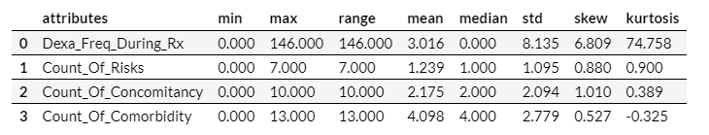
Profit Analysis
3.1.2. Descriptive Statistical
Used to gain business knowledge and to be able to detect errors. There are two major metrics within descriptive statistics:
Central Tendency Metrics: summarize data into a single number. Ex: mean and median.
Dispersion metrics: These tell you whether the data is too concentrated near the mean or too dispersed from it. Ex: Variance, standard deviation, minimum and maximum, range, Skew and Kurtosis.
For example, the attribute Dexa_Freq_During_RX have a very high range and kurtosis, which means that the feature has a large number of values concentrated at a same value, for example, there are several values equal 0. Also, its range is very different of the others attributes, which means that it can cause a problem at the model training, and has to be fixed.

Slide 9
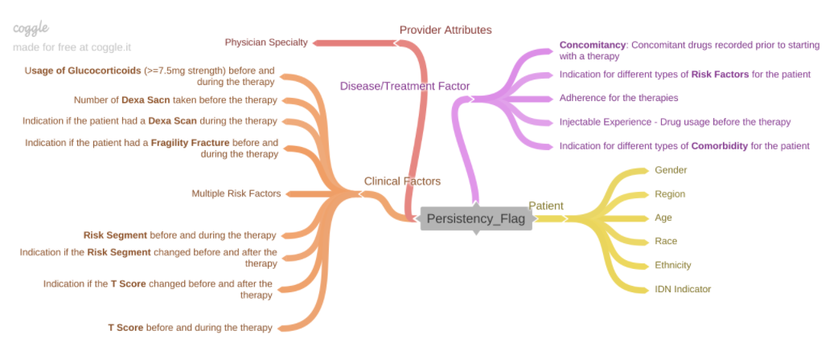
3.2. Mind Map Hypothesis
This mind map is a guide for exploratory data analysis.
It describes in the centre, the phenomenon that should be modelled, in this case the Persistency Flag attribute.
The first level are all the entities that impact this phenomenon, making the persistence to be yes or no.
In the last level there are the attributes that describe the entities by themselves.
This allows us to create hypotheses about them and guide us during the exploratory data analysis.

Slide 10
3.3. EDA Hypothesis
3.3.1. Patient Hypothesis
1. Female patients are more persistent of a drug than male.
2. Patients from Northeast are more persistent of a drug than patients from South.
3. Patients over 65 years of age are more persistent of a drug than patients 65 years of age or younger.
4. Caucasian patients, not Hispanic are more persistent of a drug than patients with different race and ethnicity.
5. Patients mapped to IDN are more persistent of a drug than patient not mapped.

Slide 11
3.3.2. Provider Attributes Hypothesis
6. Patients that received the drug prescription from General Practitioner Specialty are less persistent of a drug than patients that received the drug prescription from others Specialty.
3.3.3. Clinical Factors Hypothesis
7. Patients that used Glucocorticoid and had a Fragility Fracture, before and during the therapy, are more persistent of a drug than patients that not used Glucocorticoid neither had a Fragility Fracture, in any situation.
8. Patients that had Dexa Scan more than 0 times are more persistent of a drug than patients that had Dexa Scan less than 0 times.
9. Patients that presents VLR_LR as Risk Segment during the therapy and presents Unknown value in Risk Segment after the therapy are more persistent of a drug than patients that presents other types of Risk Segment and Change in Risk Segment.
10. Patients that presents T Socre of >-2.5 before the therapy and presents No Change T Score status after the therapy are less persistent of a drug than patients that presents other types of T Score and T Score status.

Slide 12
3.3.4. Disease/Treatment Factor Hypothesis
11. Patients that presents the amount of risk factor higher than 1 are more persistent of a drug than patients that presents the amount of risk factor lower than 1.
12. Patients adherent for therapies and that used drugs before the therapy are more persistent of a drug than patients in different satiations related to both attributes.
13. Patients that used more than 2 concomitancy drugs before the therapy are less persistent of a drug than patients that used more than 2 concomitancy drugs before the therapy.
14. Patients that presents more than 3 different types of comorbidity are more persistent of a drug than patients that presents less than 3 different types of comorbidity.

Slide 13
3.4. Exploratory Data Analysis (EDA)
EDA is a step in a data science process where we dive into the data and start to understand some behaviours that visually or through data manipulation, become clearer.
With EDA it is possible to gain business experience, to understand how the business works, and to also understand the behaviour that the business has through the data.
Here also, we validate or refute the hypotheses.
This information provided by the hypotheses can be very useful and assists in the decision making process.
Each validated or discarded hypothesis is called insight.
The creation of insights is generated through surprise and through the counterpoint of the CEO's belief. It surprises and/or alters the CEO's belief about the business.

Slide 14
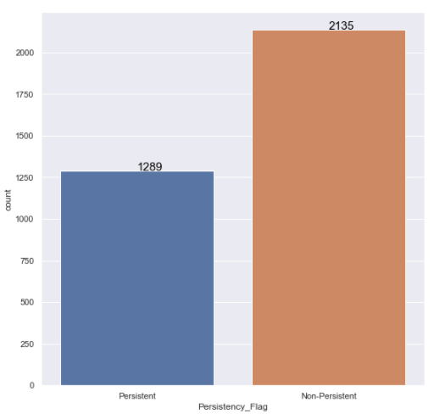
3.4.1. Target Variable
On this bar graph, the blue bar informs the quantity of patients that persist in the use of the drug during the whole treatment.
The orange bar informs the quantity of patients that do not persist in the use of the drug, i.e., give up the use of the drug before finishing the treatment.
As it is possible to analyse, the quantity of patients that do not persist in the use of the drug during the treatment is bigger than the quantity of patients that persist.

Slide 15
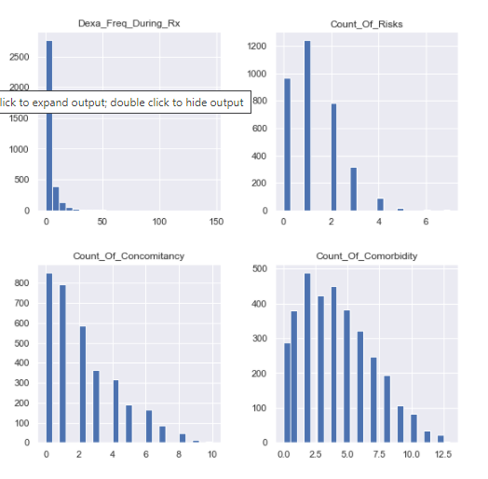
3.4.2. Numerical Variables
All numerical attributes show a well varied behaviour, not stagnated, presenting relevant information for the learning of the ML model. In other words, this information can help to obtain more accuracy in the evaluation of the ML model.
All variables show a positive skew, tending to the left.
The variable 'Dexa_Freq_During_Rx' presents a very high kurtosis, because its values are extremely concentrated on the value 0.
The other variables report that the majority of patients demonstrate an amount of risk, concomitancy and comorbidity between 0 and 2.5.
And patients who show more risk, more concomitancy and more comorbidity, are in smaller numbers.

Slide 16
3.4.3. Hypothesis Validation
With the assistance of graphs it will be verified if the hypotheses are true or not.

Slide 17
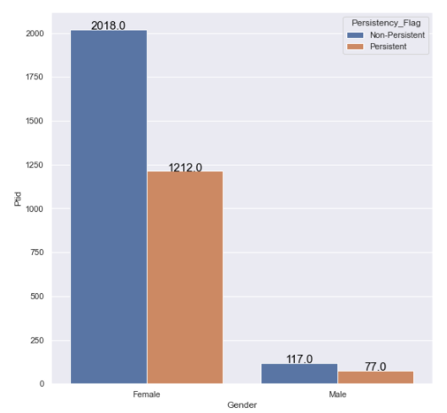
Hypotheses 1: Female patients are more persistent of a drug than male.
TRUE There are 1135 more persistent female patients than male patients.

Slide 18
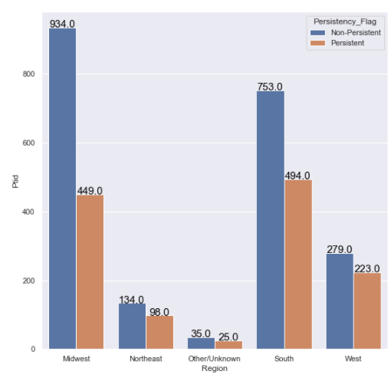
Hypotheses 2: Patients from Northeast are more persistent of a drug than patients from South.
FALSE Comparing patients from the Northeast and South, there are 396 more persistent patients from the South than from the Northeast.

Slide 19
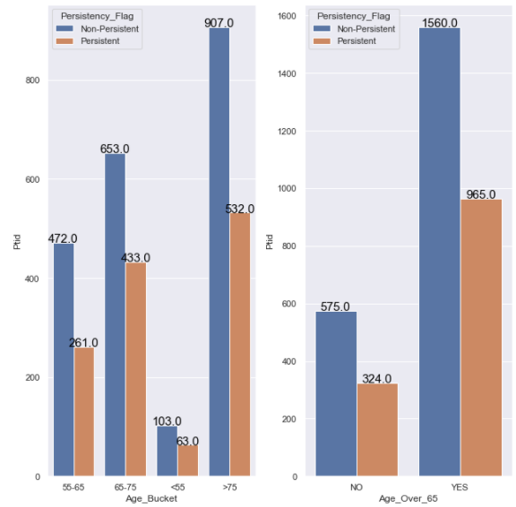
Hypotheses 3: Patients over 65 years of age are more persistent of a drug than patients 65 years of age or younger.
TRUE There are 641 more persistent patients over 65 years of age than patients younger than 65 years of age.

Slide 20
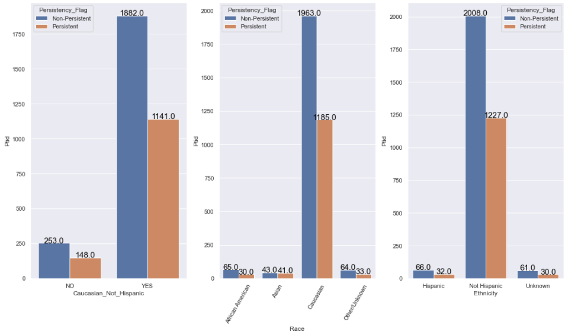
Hypotheses 4: Caucasian patients, not Hispanic are more persistent of a drug than patients with different race and ethnicity.
TRUE There are 993 more Caucasian & not Hispanic persistent patients than patients from different race and ethnicity.

Slide 21
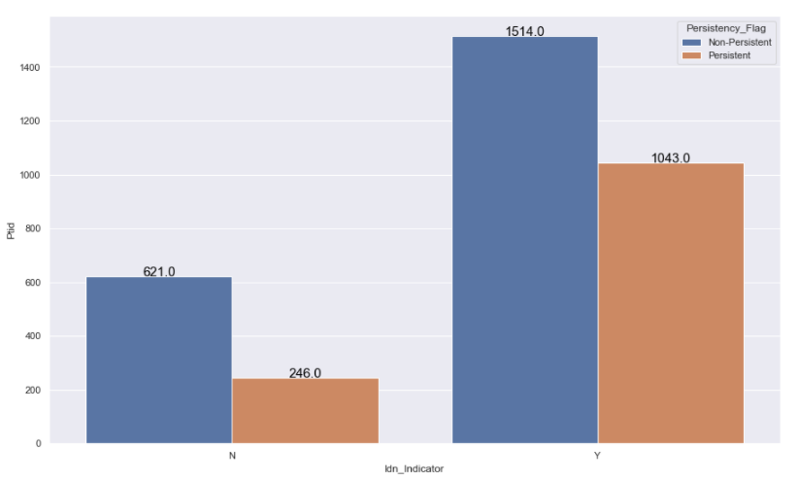
Hypotheses 5: Patients mapped to IDN are more persistent of a drug than patient not mapped.
TRUE There are 797 more persistent patients mapped to IDN than persistent patients not mapped to IDN.

Slide 22
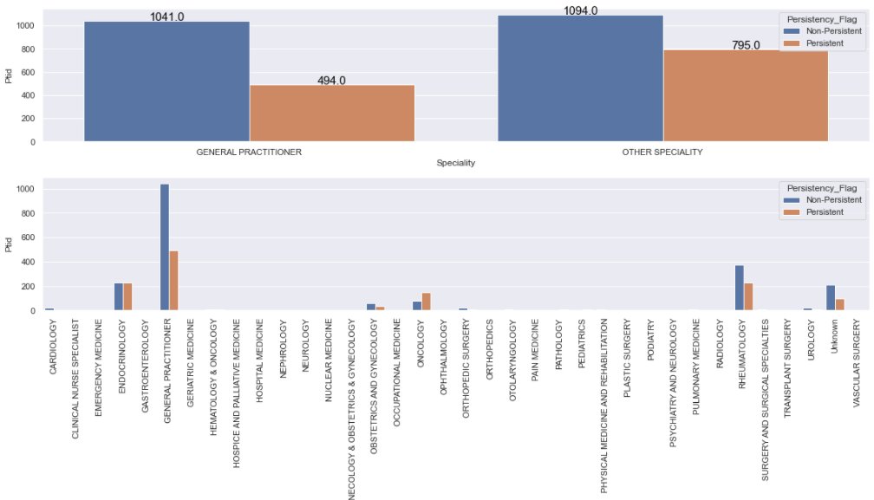
Hypotheses 6: Patients that received the drug prescription from General Practitioner Specialty are less persistent of a drug than patients that received the drug prescription from others Specialty.
FALSE There are 301 more persistent patients that received the drug prescription from others Specialty than persistent patients that received the drug prescription from General Practitioner Specialty.

Slide 23
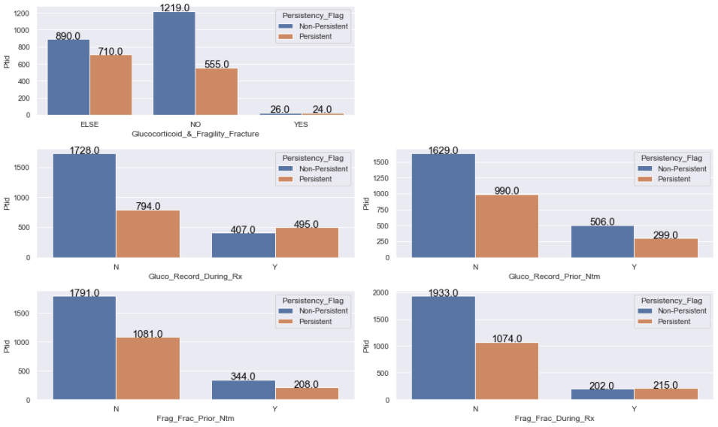
Hypotheses 7: Patients that used Glucocorticoid and had a Fragility Fracture, before and during the therapy, are more persistent of a drug than patients that not used Glucocorticoid either had a Fragility Fracture, in any situation.
FALSE There are 531 more persistent patients that did not use Glucocorticoid neither had a Fragility Fracture than persistent patients that used Glucocorticoid and had a Fragility Fracture.

Slide 24
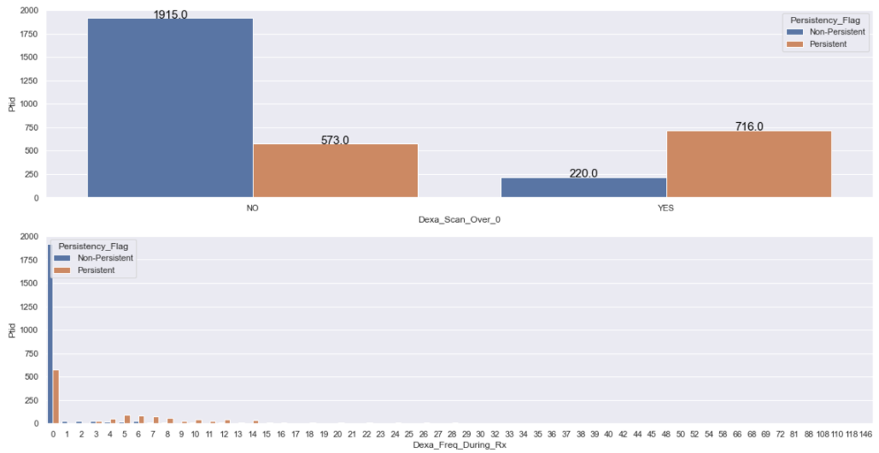
Hypotheses 8: Patients that had Dexa Scan more than 0 times are more persistent of a drug than patients that had Dexa Scan 0 times.
FALSE There are 185 more persistent patients that had Dexa Scan more than 0 times than persistent patients that that had Dexa Scan 0 times.

Slide 25
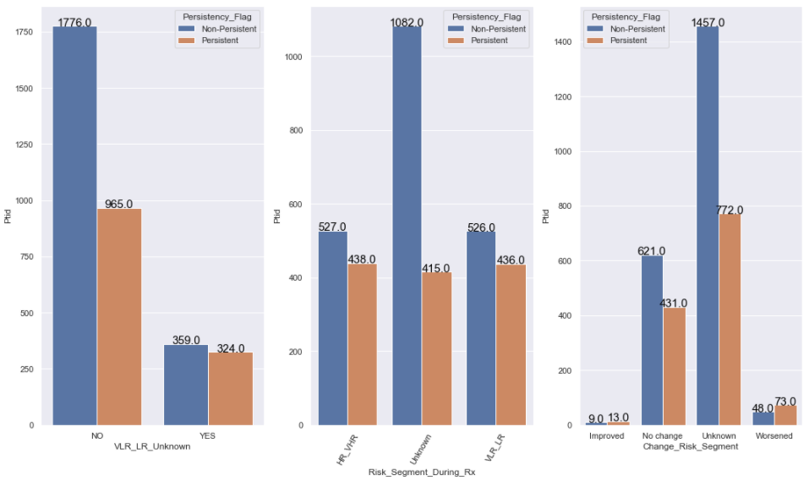
Hypotheses 9: Patients that presents VLR_LR as Risk Segment during the therapy and presents Unknown value in Risk Segment after the therapy are more persistent of a drug than patients that present other types of Risk Segment and Change in Risk Segment.
FALSE There are 641 more persistent patients that presents other types of Risk Segment and Change on Risk Segment than persistent patients that presents VLR_LR as Risk Segment during the therapy and presents Unknown value in Risk Segment after the therapy .

Slide 26
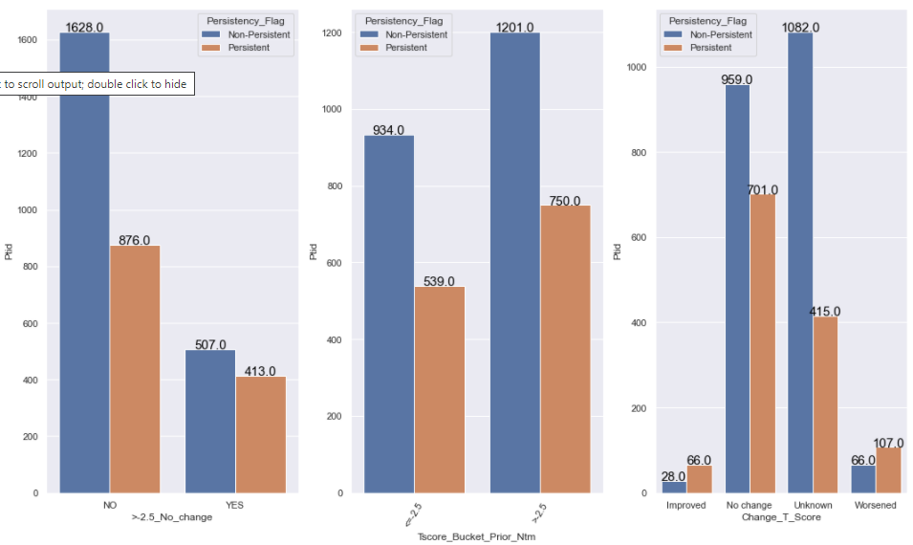
Hypotheses 10: Patients that presents T Socre of >-2.5 before the therapy and presents No Change T Score status after the therapy are less persistent of a drug than patients that presents other types of T Score and T Score status.
TRUE There are 463 more persistent patients that presents other types of T Score and Change on T Score than persistent patients that presents T Score of >-2.5 before the therapy and presents No Change T Score status after the therapy.

Slide 27
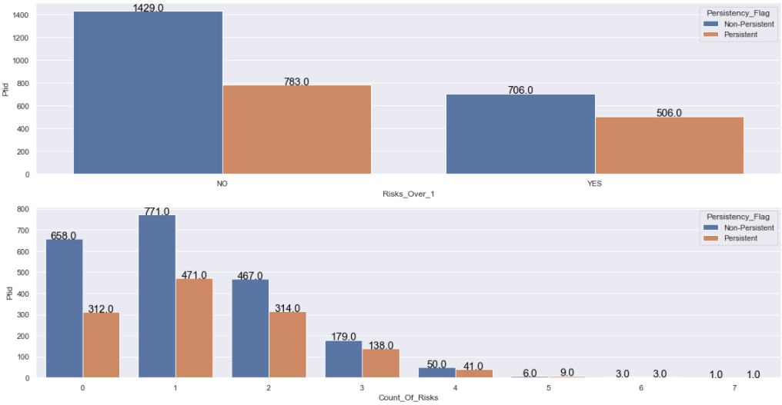
Hypotheses 11: Patients that presents the amount of risk factor higher than 1 are more persistent of a drug than patients that presents the amount of risk factor lower than 1.
FALSE There are 277 more persistent patients that do not presents the amount of risk factor higher than 1 than persistent patients that presents the amount of risk factor higher than 1.

Slide 28
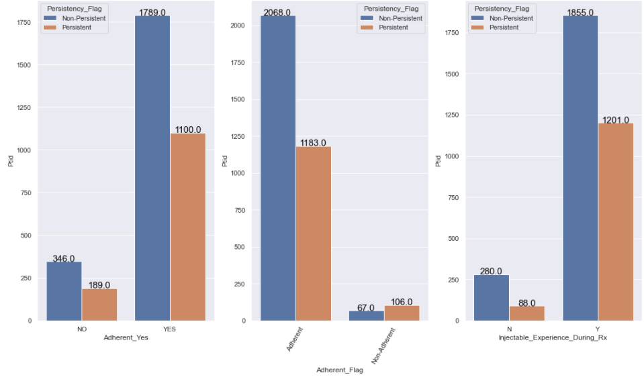
Hypotheses 12: Patients adherent for therapies and that used drugs during the therapy are more persistent of a drug than patients in different situations related to both attributes.
TRUE There are 189 more persistent patients adherent for therapies and that used drugs before the therapy than persistent are not adherent for therapies and that did not use drugs before the therapy.

Slide 29
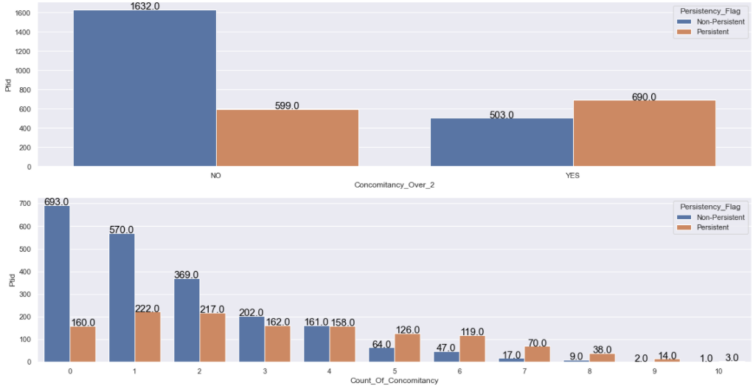
Hypotheses 13: Patients that used more than 2 concomitancy drugs before the therapy are less persistent of a drug than patients that used more than 2 concomitancy drugs before the therapy.
FALSE There are 91 more persistent patients that used more than 2 concomitancy drugs before the therapy persistent patients that used less than 3 concomitancy drugs before the therapy.

Slide 30
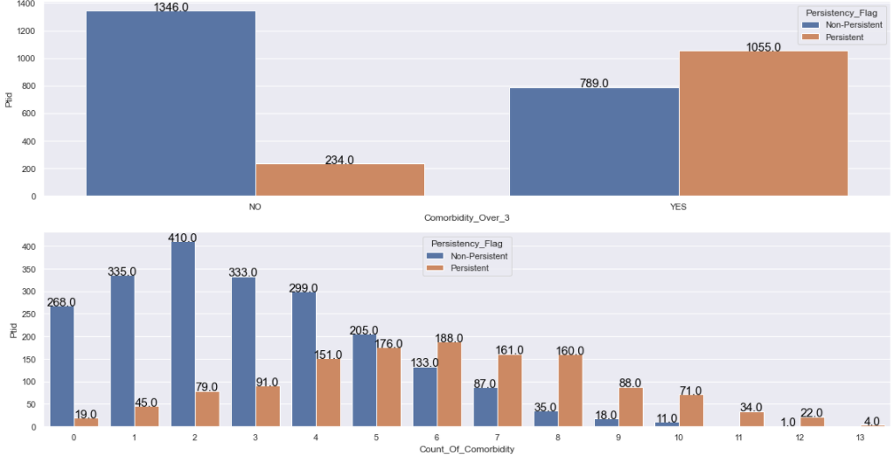
Hypotheses 14: Patients that presents more than 3 different types of comorbidity are more persistent of a drug than patients that present less than 3 different types of comorbidity.
TRUE There are 821 more persistent patients that presents more than 3 different types of comorbidity than persistent patients that do not presents more than 3 different types of comorbidity.

Slide 31
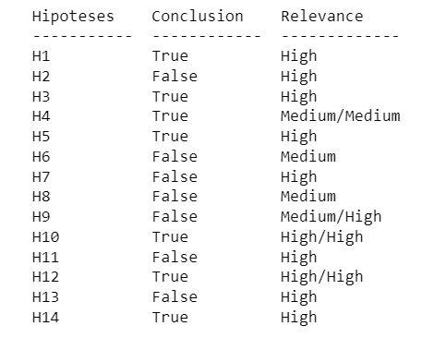
3.4.4. Summary of Hypothesis
This summary of hypotheses informs which hypotheses were validated as true and which were not validated.
Relevance indicates which attributes are important for training the classification model, i.e., it tells which attributes can help in achieving a high classification accuracy (higher number of successful classifications).

Slide 32
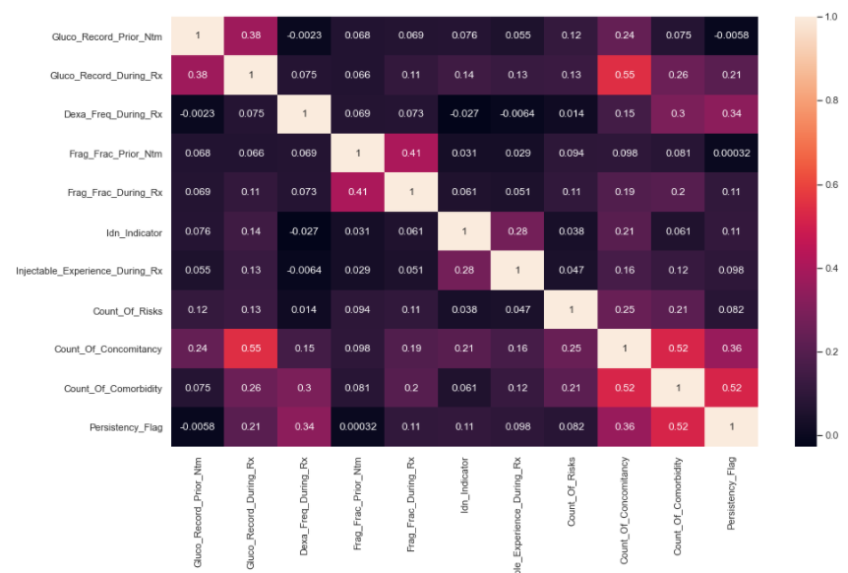
3.5. Multivariate Analysis – Numerical Variables
In this numerical analysis matrix, all rows and all columns are all numerical attributes.
This graph informs the correlation between the attributes.
The closer to the white the higher is the positive correlation between them.
The closer to black the higher the negative correlation between them.
If the attributes present a high correlation between them (both positive and negative) it means that they have the same type of information. With this we can eliminate one of them, reducing the dimensionality of the dataset.
This dimensionality reduction represents better chances for the classification model to obtain a high accuracy (higher number of successful classifications).

Slide 33
4. Conclusion
Based on all the Insights created from this dataset, patients who have a higher probability of persisting of a drug for the entire treatment, have the following characteristics:
Female;
Patients older than 65 years;
Caucasian non-Hispanic Patients;
Patients mapped to IDN;
Patients that received the drug prescription from General Practitioner Specialty;
Patients who did not use Glucocorticoid and had Fragility Fracture;
Patients who had no Dexa Scan;
Patient’s adherent for therapies and that used drugs before the therapy.

Slide 34
5. Next Steps – Recommended ML Models
The target variable Persistent Flag is of type binary class, i.e., it has only two classification values, in this case, Persistent or Non-Persistent.
Due to this fact some Machine Learning algorithms are recommended and used at this business problem, such as:
Random Forest & Extra Trees Classifier:
Decision Tree models are very used in Machine Learning
Decision Tree algorithms are widely used in Machine Learning, both for regression and classification. Although they have a high computational cost, they usually provide good results.
Among all decision tree algorithms, the most used is the Random Forest. It is the algorithm that presents the highest computational cost, but its results are always good to excellent in most applications.
Extra Trees is good as well, however unlike Random Forest, which chooses the optimum split, Extra Trees chooses it randomly, which is also a good application for classification models.
Support Vector Machine:
This model is specific for classification algorithm is very indicated for binary classes. Usually, in this time of problem, presents very good results with a computational cost not high.

Slide 35
5. Next Steps – Recommended ML Models – part 2
Stochastic Gradient Descent:
Stochastic gradient descent is a very popular and common algorithm used in various Machine Learning algorithms, most importantly forms the basis of Neural Networks.
LGBM Classifier:
Light GBM is a fast, distributed, high-performance gradient boosting framework based on decision tree algorithm, used for ranking, classification and many other machine learning tasks.
It is a very good algorithm because combines the advantages of decision tree algorithms with boosting algorithm. Boosting algorithms lately are very popular algorithm with high capabilities, very powerful and winner of different competition on Kaggle for example.
However unlike decision tree and boosting algorithms, Light GBM can be adaptable to dataset with lots of data, taking less time to training the model the other algorithms.

Slide 36
Thank You

